Slide 1
Recursive & Reverse (Function & languages) Induction Proof (Examples Exercise)
Lecture 4

Slide 2
Recursive
Definition
It is a three step process
1) Drive basic object in set
2) Give rule for constructing more object in given set.
3) No object can be derived from another way except from defined rules.

Slide 3
Example 1
Problem:
Methode-1: EVEN is the set of all positive whole numbers divisible by 2
Methode-2 : EVEN is the set of all 2n where
n= 1 2 3 4 5 . . . .
But according to recursive definition:
Rule-1: 2 is EVEN
Rule-2: if x is in EVEN, then so is x+2.
Rule-3: the only element in the set EVEN are those that can be produced from two rules above

Slide 4
Example 1
Solution:
By rule-1: 2 is even
By rule-2: 2+2=4 is also EVEN
Again be rule-2: 4+2=6, 6+2=8, and so on are EVEN.
Another description of EVEN numbers:
Rule-1: 2 is EVEN
Rule-2: if x and y both are EVEN then so is
x+y

Slide 5
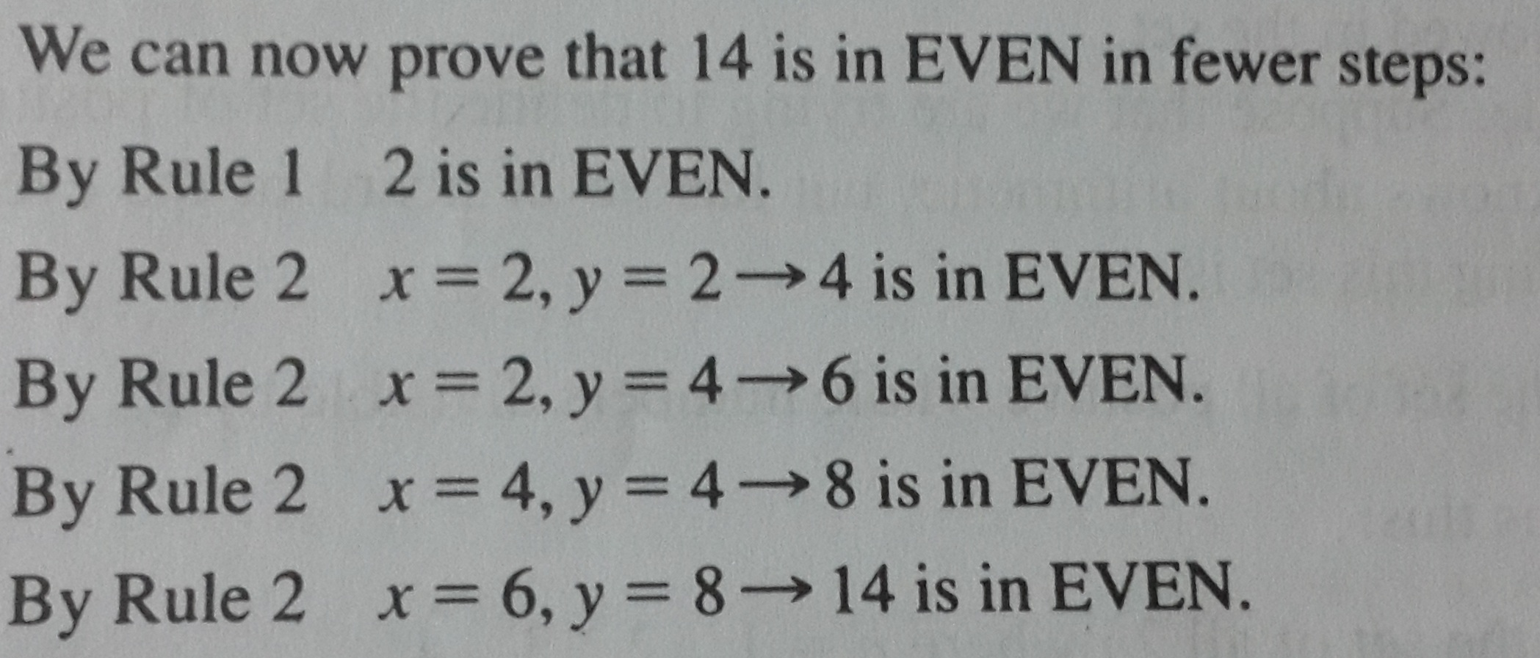
Example 2

Slide 6
Example 2
Problem:
Recursive definition for POSITIVE integers:
.
According to recursive definition:
Rule-1: 1 is in INTEGERS
Rule-2: if x is in INTEGERS, then so is x+1.
OR
Rule-1: 1 is in INTEGERS
Rule-2: if both x and y are in INTEGERS, then so are x+y and x-y.

Slide 7
Language with (Recursive definition)
Example 1
Rule-1: x is in L1
Rule-2: if w is any word/string in L1, then xw is also in L1.
L1= x⁺={x xx xxx . . .}
Example 2
Rule-1: ε is in L1
Rule-2: if w is any word/string in L2, then xw is also in L1.
L1= x*={ε x xx xxx . . .}

Slide 8
EXERCISE
1)Give a recursive definition of set ODD={ 1 3 5 7…}
2)Give a recursive definition of set of string of digit
0 1 2 3 …9 that can not start with digit 0.
3)Give a recursive definition for the set:
POWER-OF-TWO={1 2 4 8 16 . . .} prove also
Product of 2^{n} x 2^{n} = 2^{n}

Slide 9
EXERCISE
Give a recursive definition of language over alphabet= {a, b}:
The language EVENSTRINGS of all words of even length.
The language ODDSTRINGS of all words of odd length.
The language AA of all words containing the substring aa.
The language NOTAA of all words not containing the substring aa.

Slide 10
Reverse Function
Definition
If w is a string/word in some language L, then reverse(w) is the same string of letters spelled backward, called reverse of w.
String=
Example :
PALINDROME= {ε , and all strings w such that reverse(w)=w}

Slide 11
Language with (Reverse function)
Definition:
Examples:
11

Slide 12
Example
An infinite language
ε
12

Slide 13
Example
If L1={a, ab, aaaa} and L2={bb,ab}
Complement:

Slide 14
Exercise
Q1
Q2
Q3

Slide 15
Exercise
Q4: LET
Σ = {a , b}
L1= {strings with an even number of a’s}
L2= { strings with no b’s}
Find L1 U L2
L2 – L1
~(L2 - L1)
Q5: LET L = { 1^{n} 2^{n} : n> 0} and is the string 122 in L.

Slide 16
Exercise
Q6 let
L1= {a ^{n} b ^{n} : n>0} and L2= { c ^{n}: n>0) for each of the following strings state whether or not is an element of L1L2:
1) empty string
2) aabbcc
3) Aabbcccc
Q7: L1={ cat, dog, mouse, bird}
L2={bone, food}
L1L2 =??

Slide 17
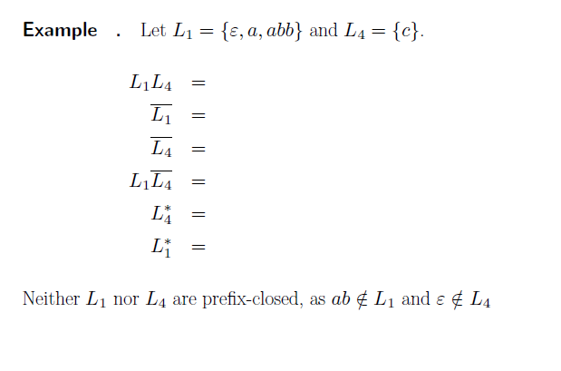
Quiz questions

Slide 18
Quiz questions
Q If is {a , b}
Then define
L(palindrome)= {write all strings such that reverse(x)=x}
And recursive definition of language which contains palindrome strings
Q Let S language= {a, b, ab}
T language= {a, g, zz }
Then define
(S³ u T²) and ~(S³ –T²)

Slide 19
What is Mathematical induction?

Slide 20
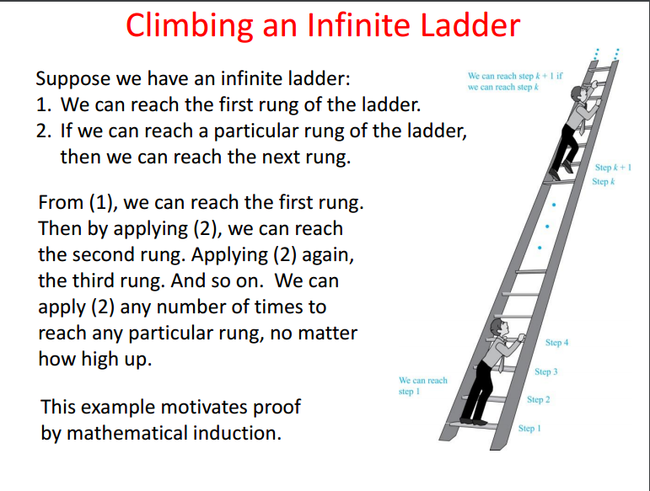

Slide 21
Mathematical induction
This proof technique is used when you want to show that something works for several cases:
Three parts:
Base case(s): show it is true for one element
Inductive hypothesis: assume it is true for any given element
Must be clearly labeled!!!
Show that if it true for the next highest element

Slide 22
Example
Problem: Show that n! < n^{n} for all n > 1
Base case: n = 2
2! < 2²
2 < 4
Inductive hypothesis: assume k! < k ^{k}
Inductive step: show that (k+1)! < (k+1)^{k+1}

Slide 23
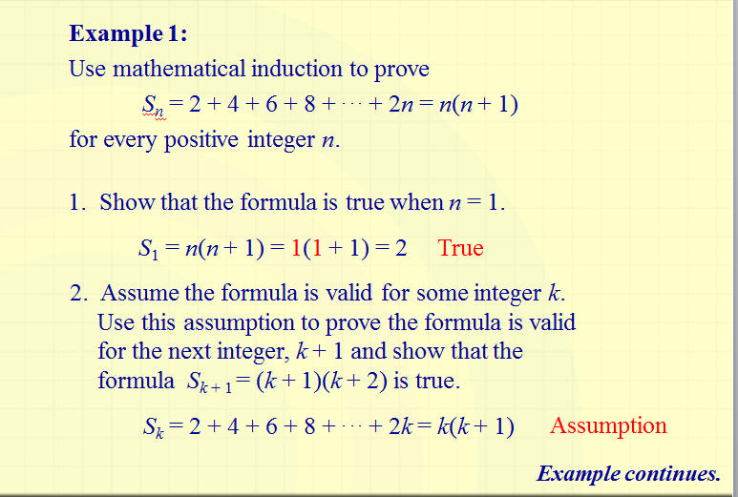

Slide 24
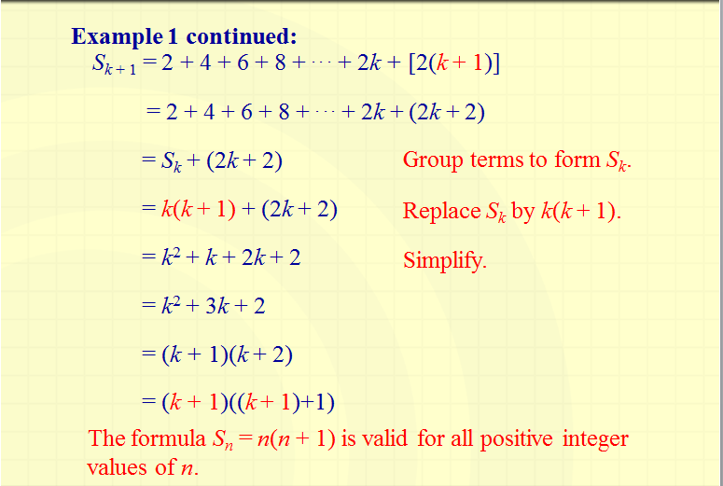

Slide 25
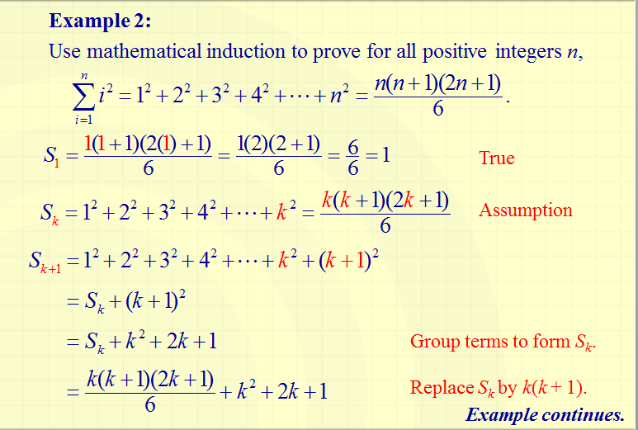

Slide 26
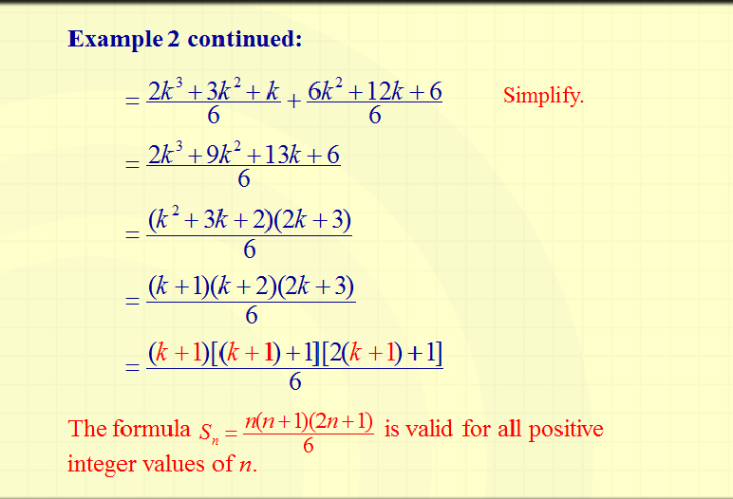

Slide 27
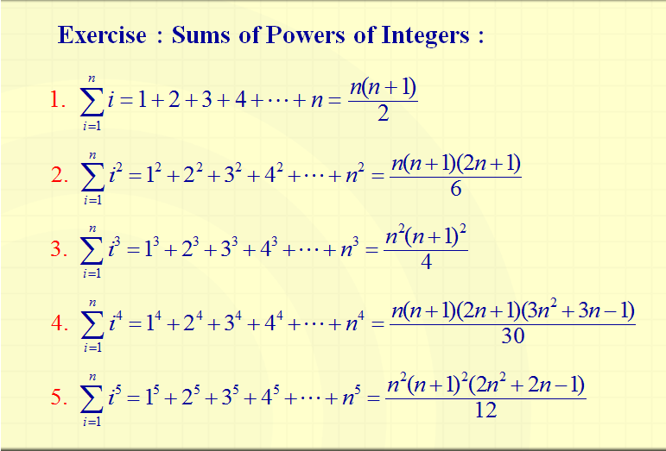

Slide 28
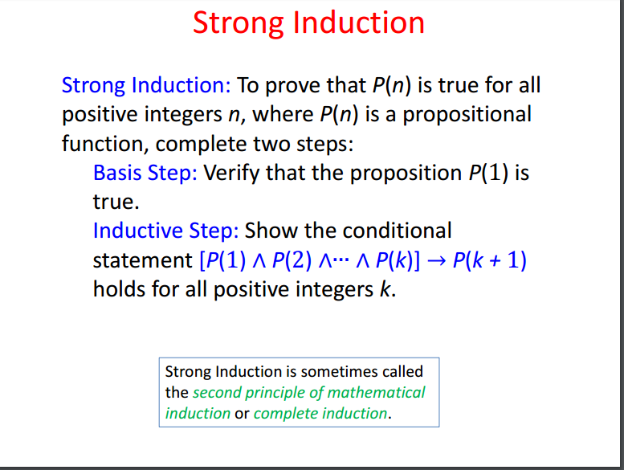

Slide 29
